Slide 1



Platformer Stealth Game
Beta Version 1.0.0
Members: Morgan, Ohana, Sengul, Suchanan (Pearl), Zhuhan
Mentor: Pragya Gurung

Slide 2



1. Introduction
2. MVP to BETA
CONTENTS
3. Storyline
4. Current State
5. Final Version project plan

Slide 3

01
Introduction

Slide 4

INTRODUCTION
For each question the player gets wrong, a defined amount of time is removed.
a platformer time-based, stealth like game
01
02
03
04
Problems are fixed by the player answering multiple choice questions.
If the player does not reach and fight the boss in the allotted time - then they lose the game.

Slide 5
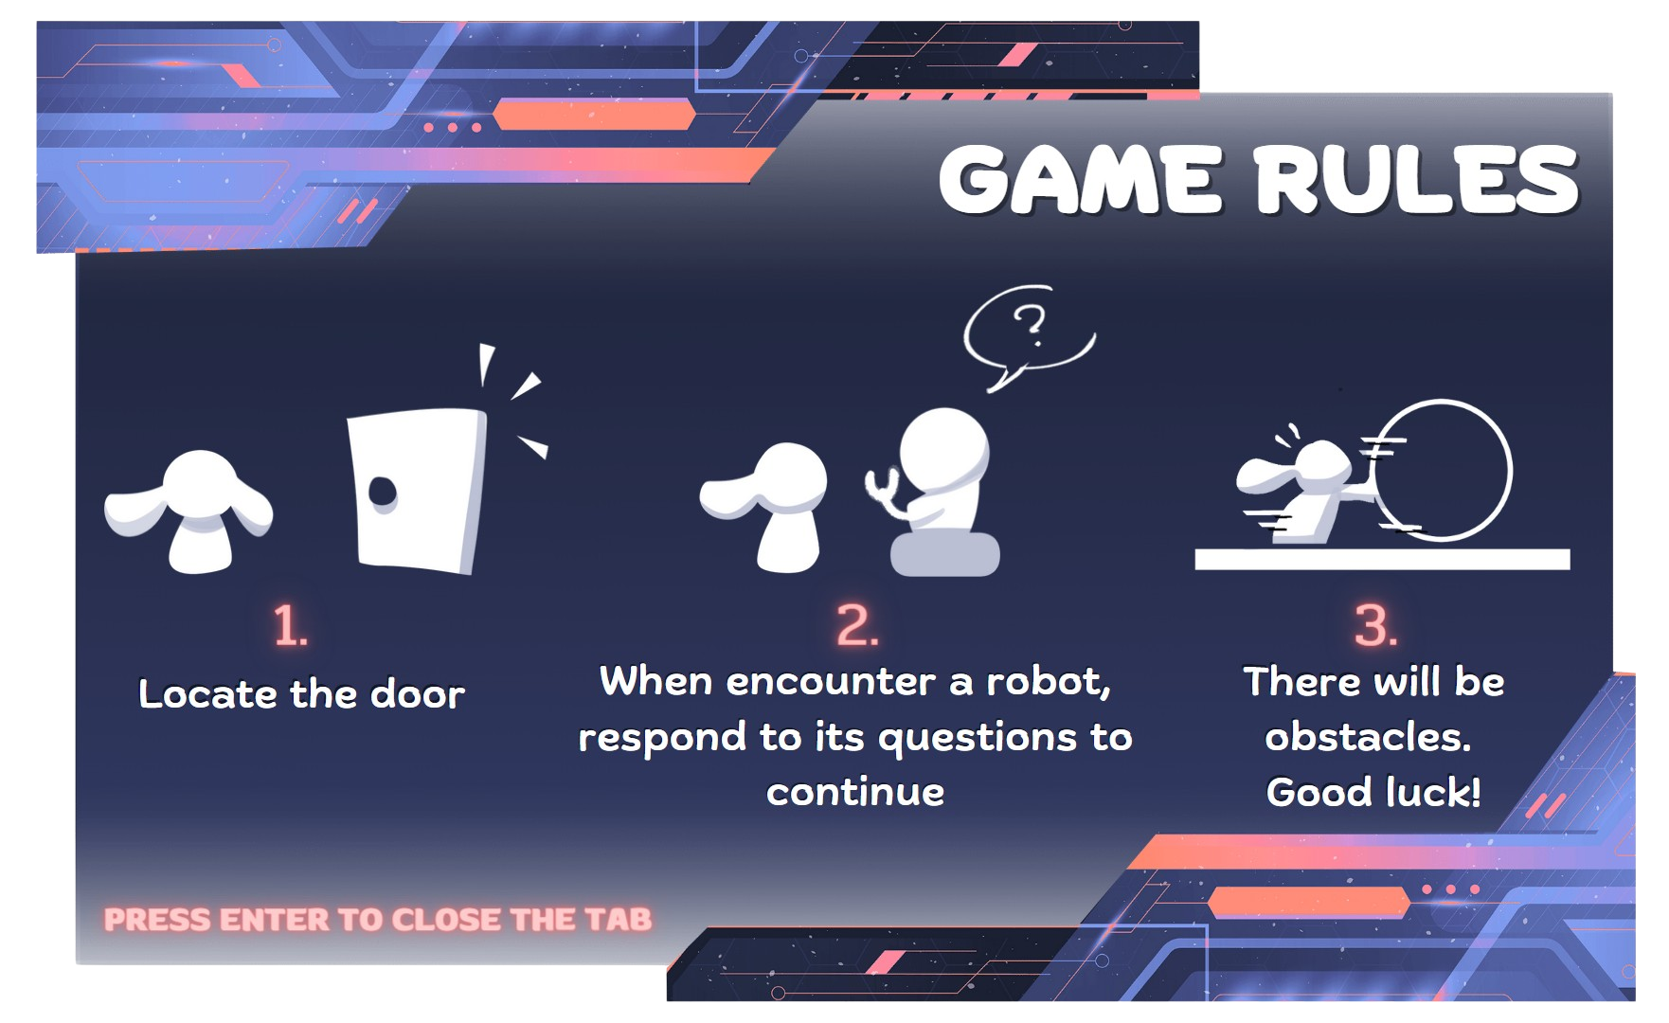

Slide 6
01
MVP to BETA version

Slide 7
The robot
Robots stay still while the game started when we get the answer wrong
Robots can trigger the question repeatedly
Interactive questions
When the player approaches the robot, a dialogue box pops up with a question
time is deducted when the player answers incorrectly
when we answered correct the player have to restart the game (bugged)
MVP VERSION
Level design
We made level 1, which was the easiest level to design
The door was not connecting to the next level
Only boulders as an obstacle
Main menu added
NPC character movements
NPCs can interact with the player movement and jumping can be controlled properly via the keyboard
NPCs can jump on/through the platform using collision effector
Animations added

Slide 8
The robot
Horizontally-moving robots which the player can interact with to answer a question
Robot is still when popup appears
Interactive questions
Questions popup overlay panel instead of a new scene
Popup includes title, randomised answer options as well as the correct answer if answered incorrectly
Game keeps track of (in/)correct answers and removes question from pool if answered correctly.
Questions are grouped by topic.
BETA VERSION
Level design
We designed level 2 and level 3, which are more complicated and have more obstacles
CCTV and laser triggers added
Animated main menu and cutscene added
Horizontally/vertically moving platforms
Npc character movements
New NPC sprite sheets (smoother animations)
Sprite can jump and move on moving platform

Slide 9
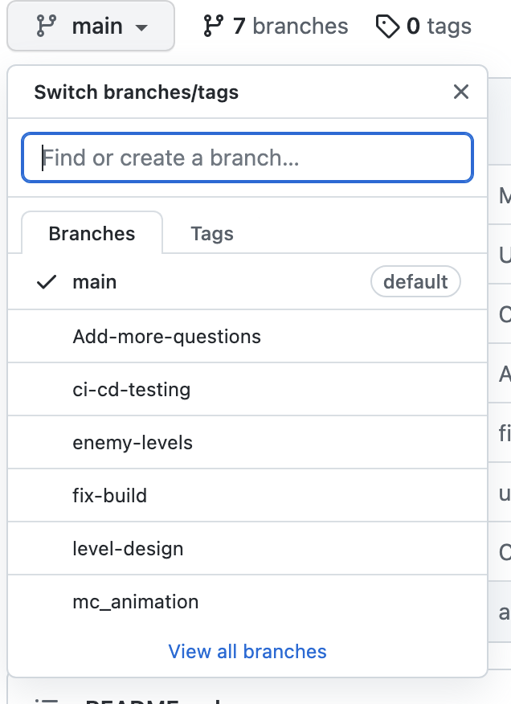

We divided the work into several parts but mainly :
Questions
Enemy-levels
Level-design
Animation
Timer

Slide 10
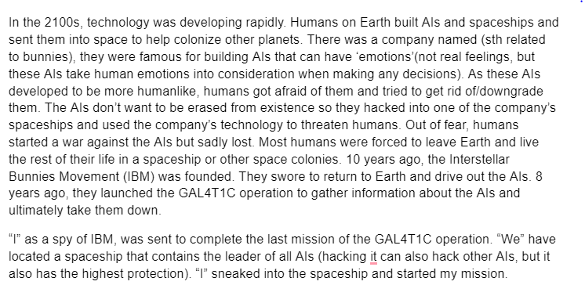
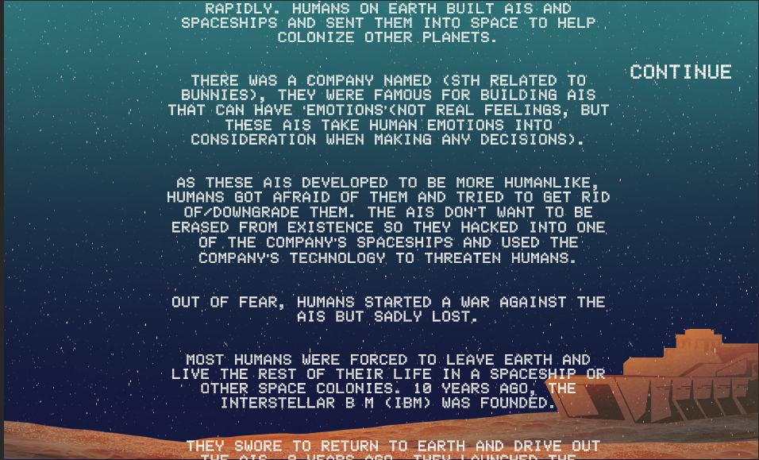

BETA
Storyline!!!
Cut scene!!!
Ending!!!

Slide 11
02
Problem

Slide 12

Buggy animations
Simple scripts
Interactive question problems (scene change)
Not enough levels

Slide 13
03
Solution

Slide 14
Test-driven development
More complex scripting
Improved proficiency with github, more frequent pull requests
Interactive questions (overlaid panel)
Created prefabs to optimize level generation

Slide 15
04
Current state

Slide 16
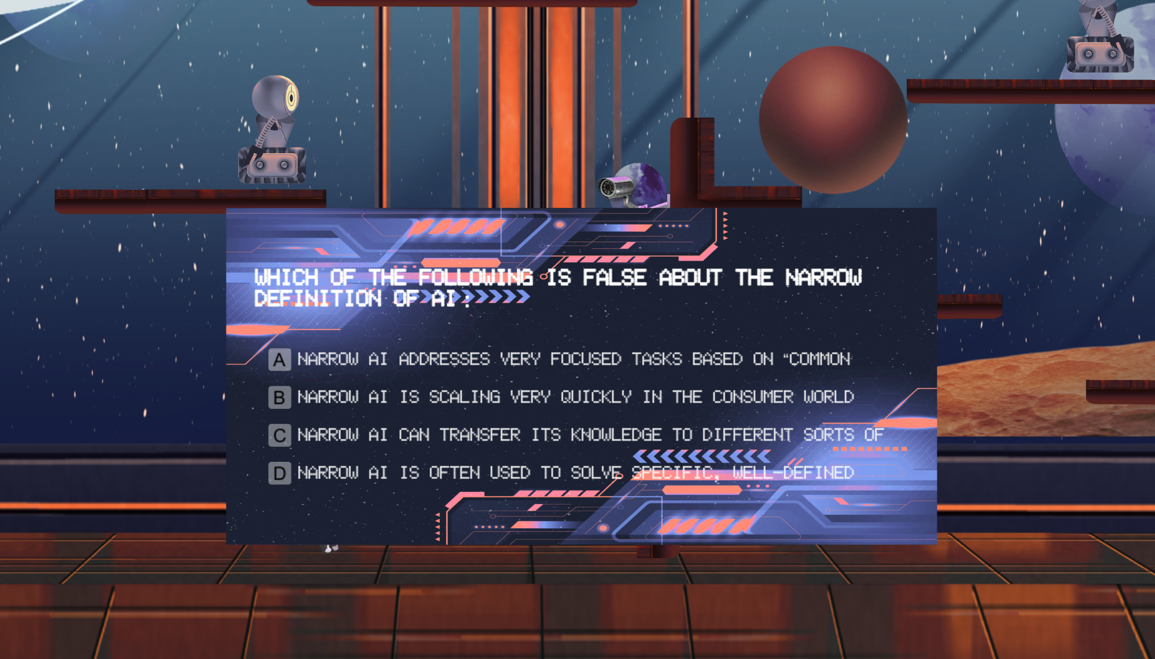
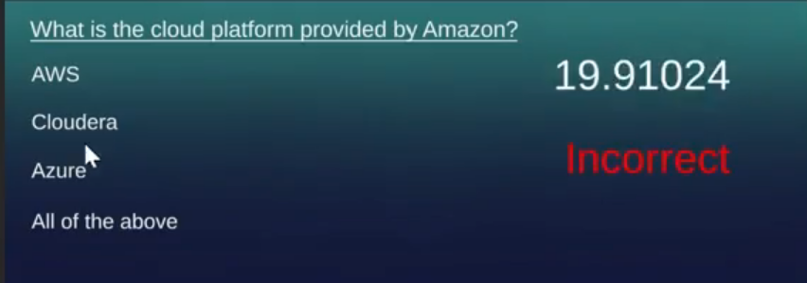
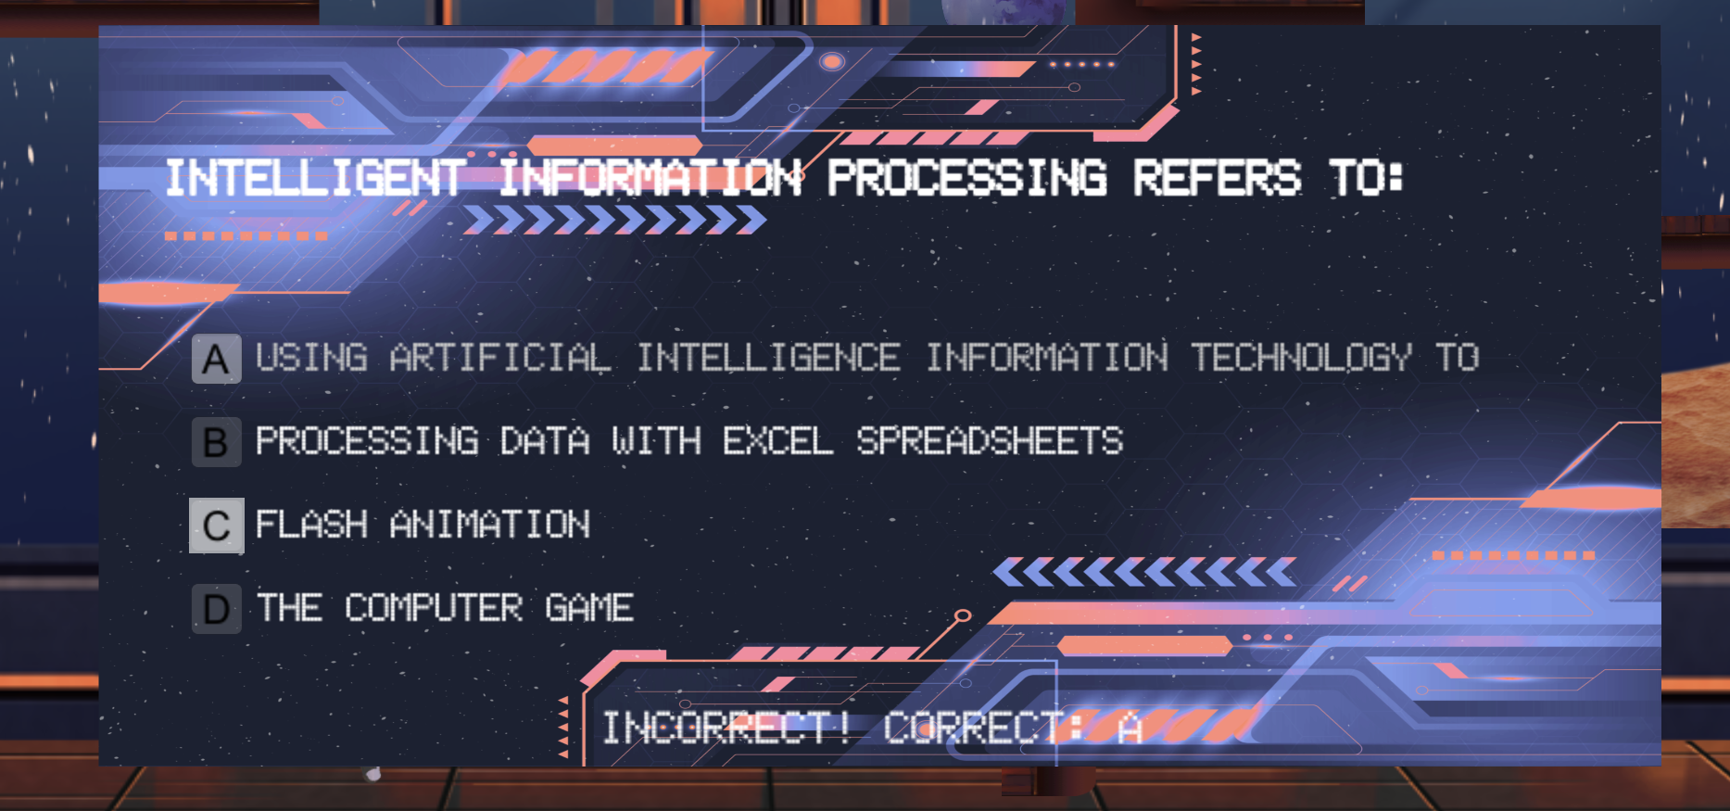
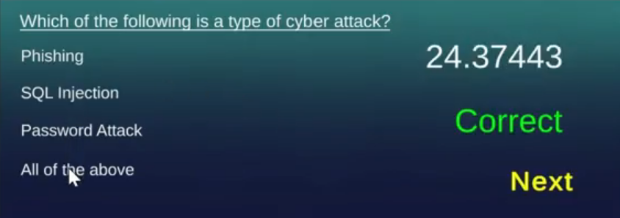
Interactive questions UI
Before
After

Slide 17

Timer
Time (in/)decrement can be changed according to difficulty level.
Timer box follows player at a fixed point on the screen.
Colour linearly interpolates as time decreases from 100% of allowance to 50%, to 0%.
(example colours are
pink-> orange -> red)

Slide 18
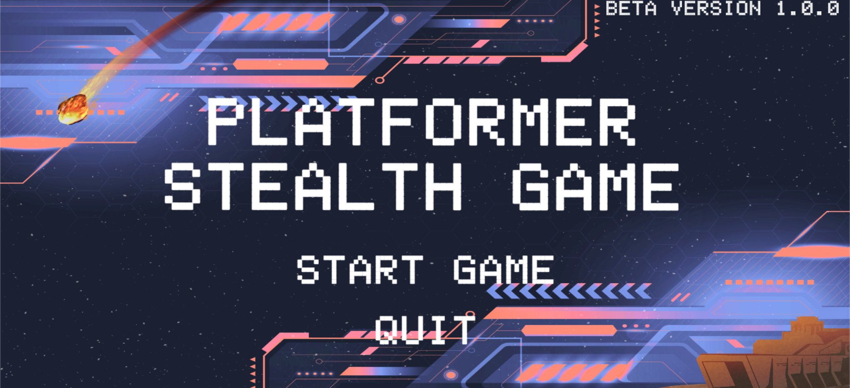
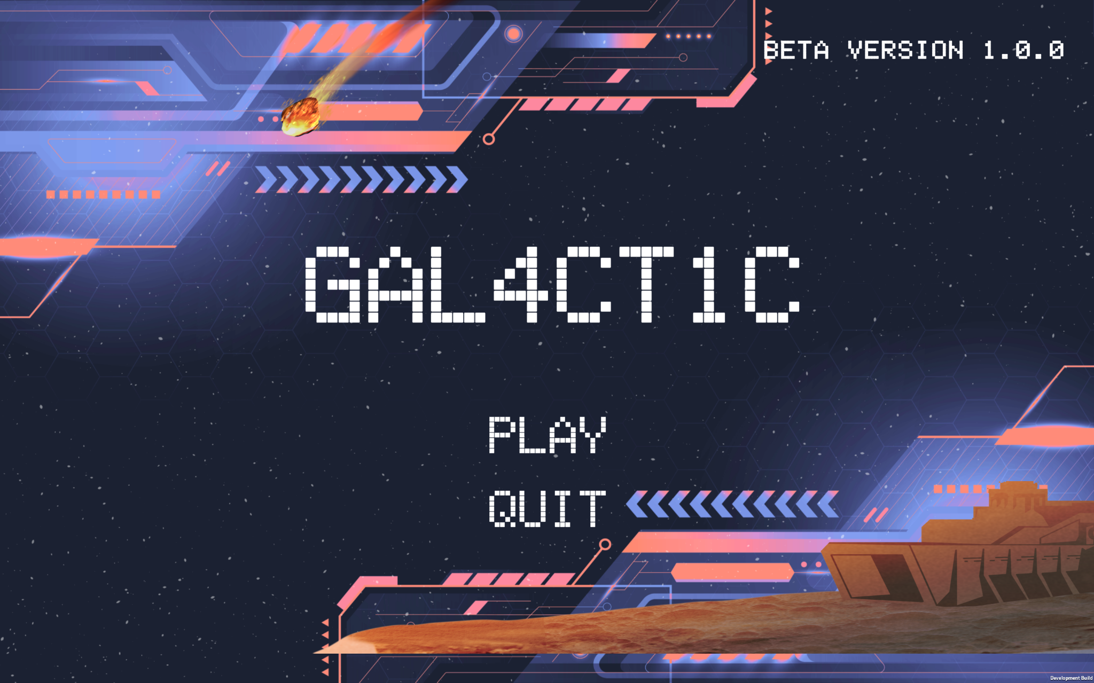
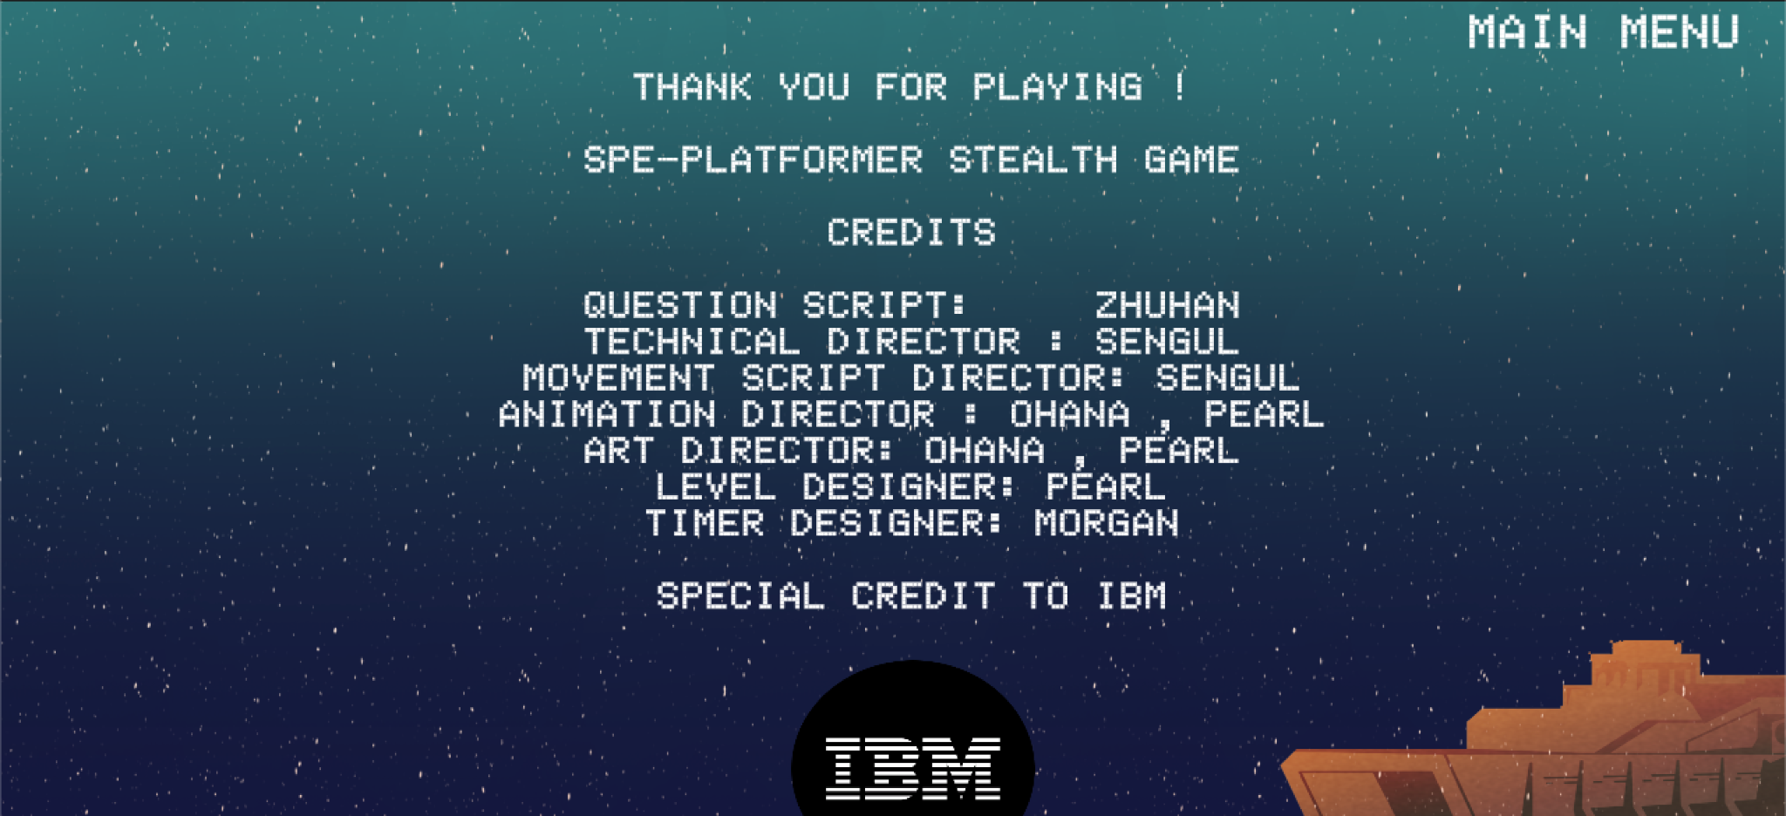
MAIN MENU
END CREDITS

Slide 19
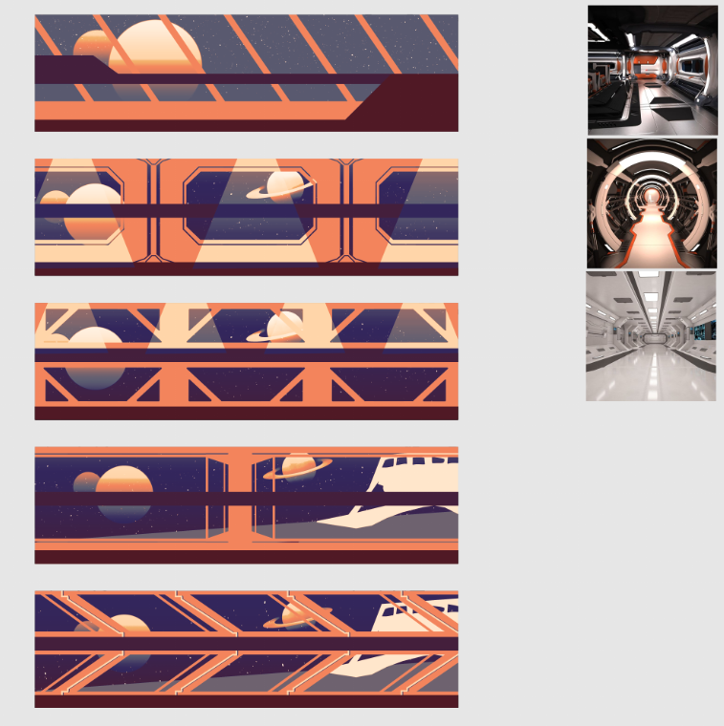
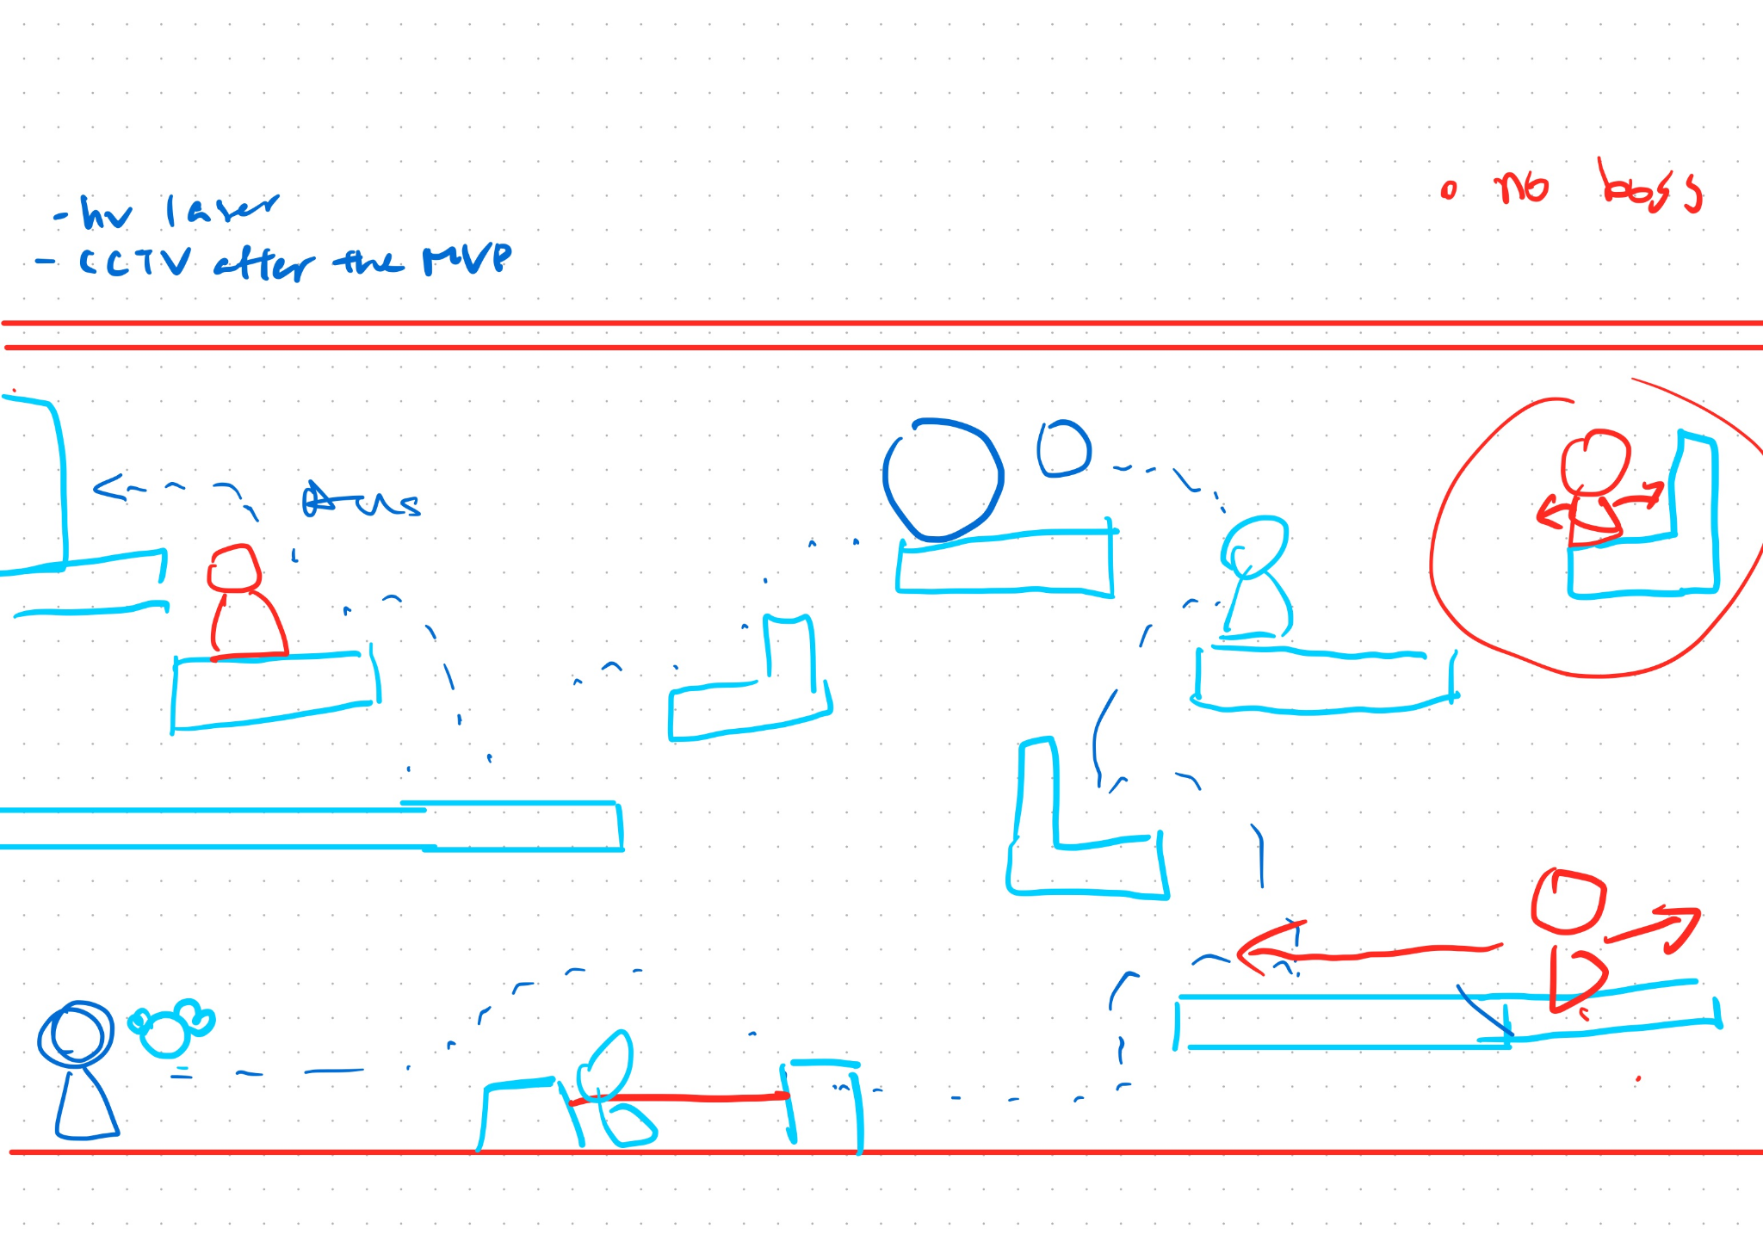
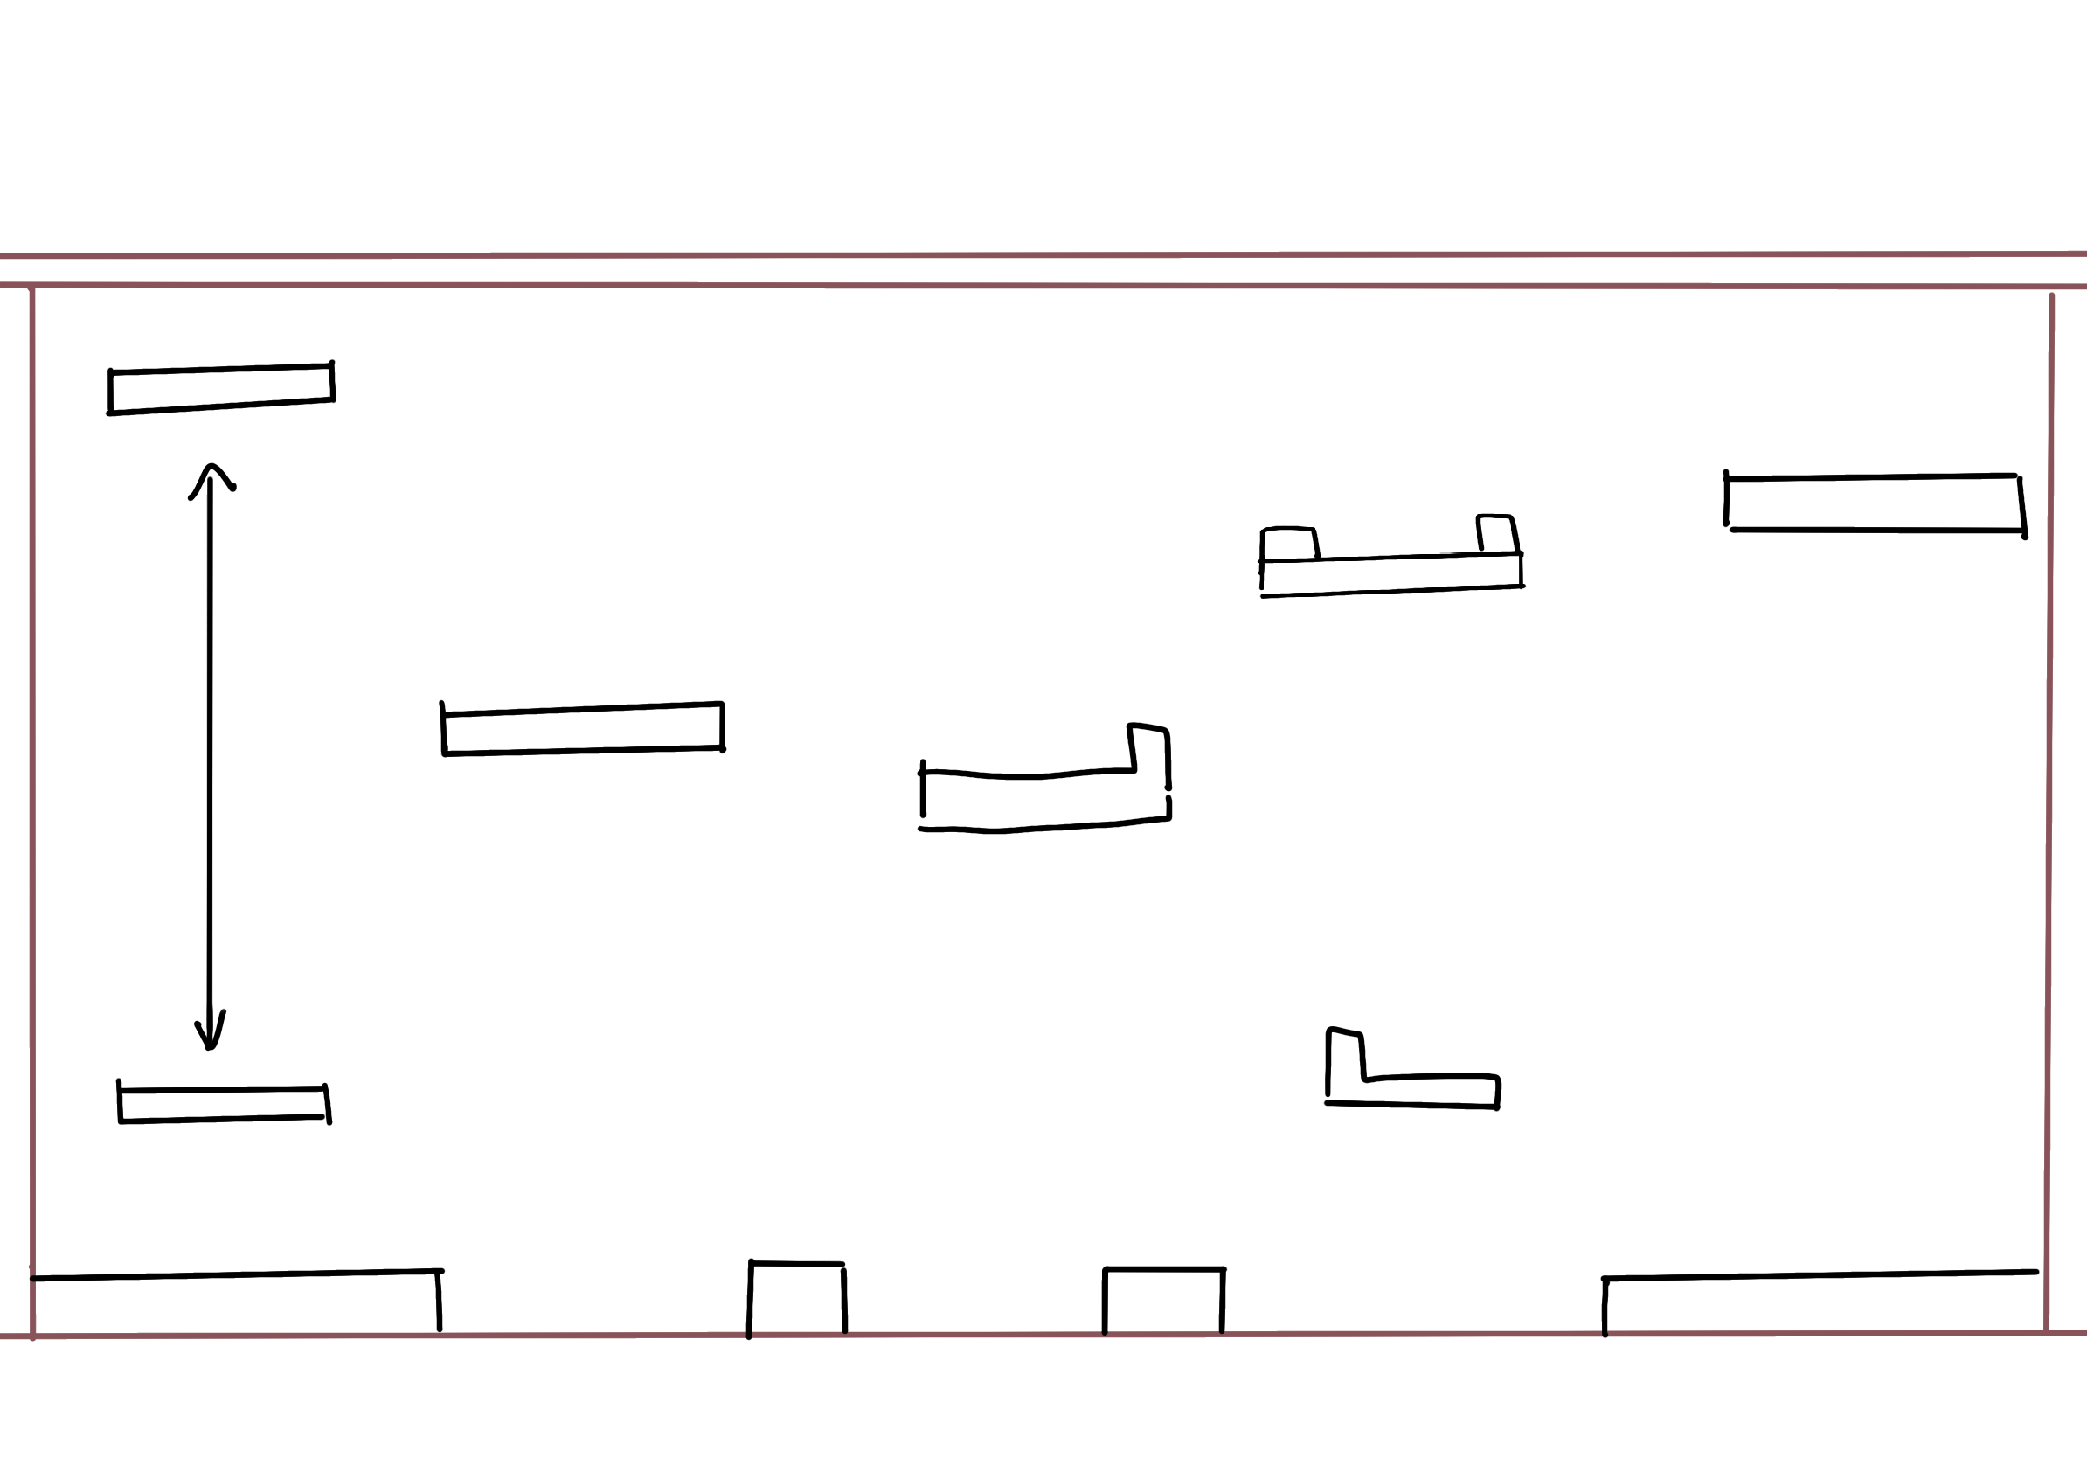
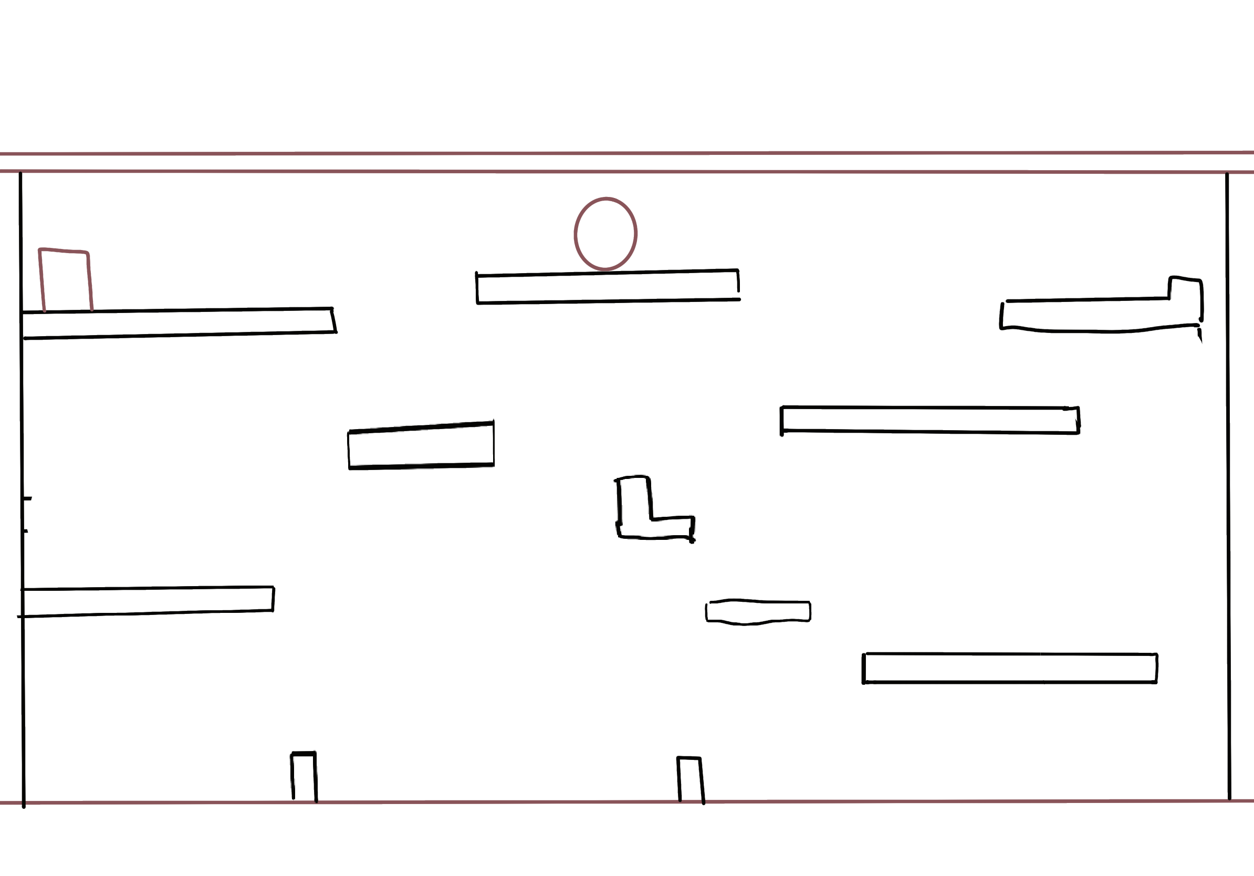
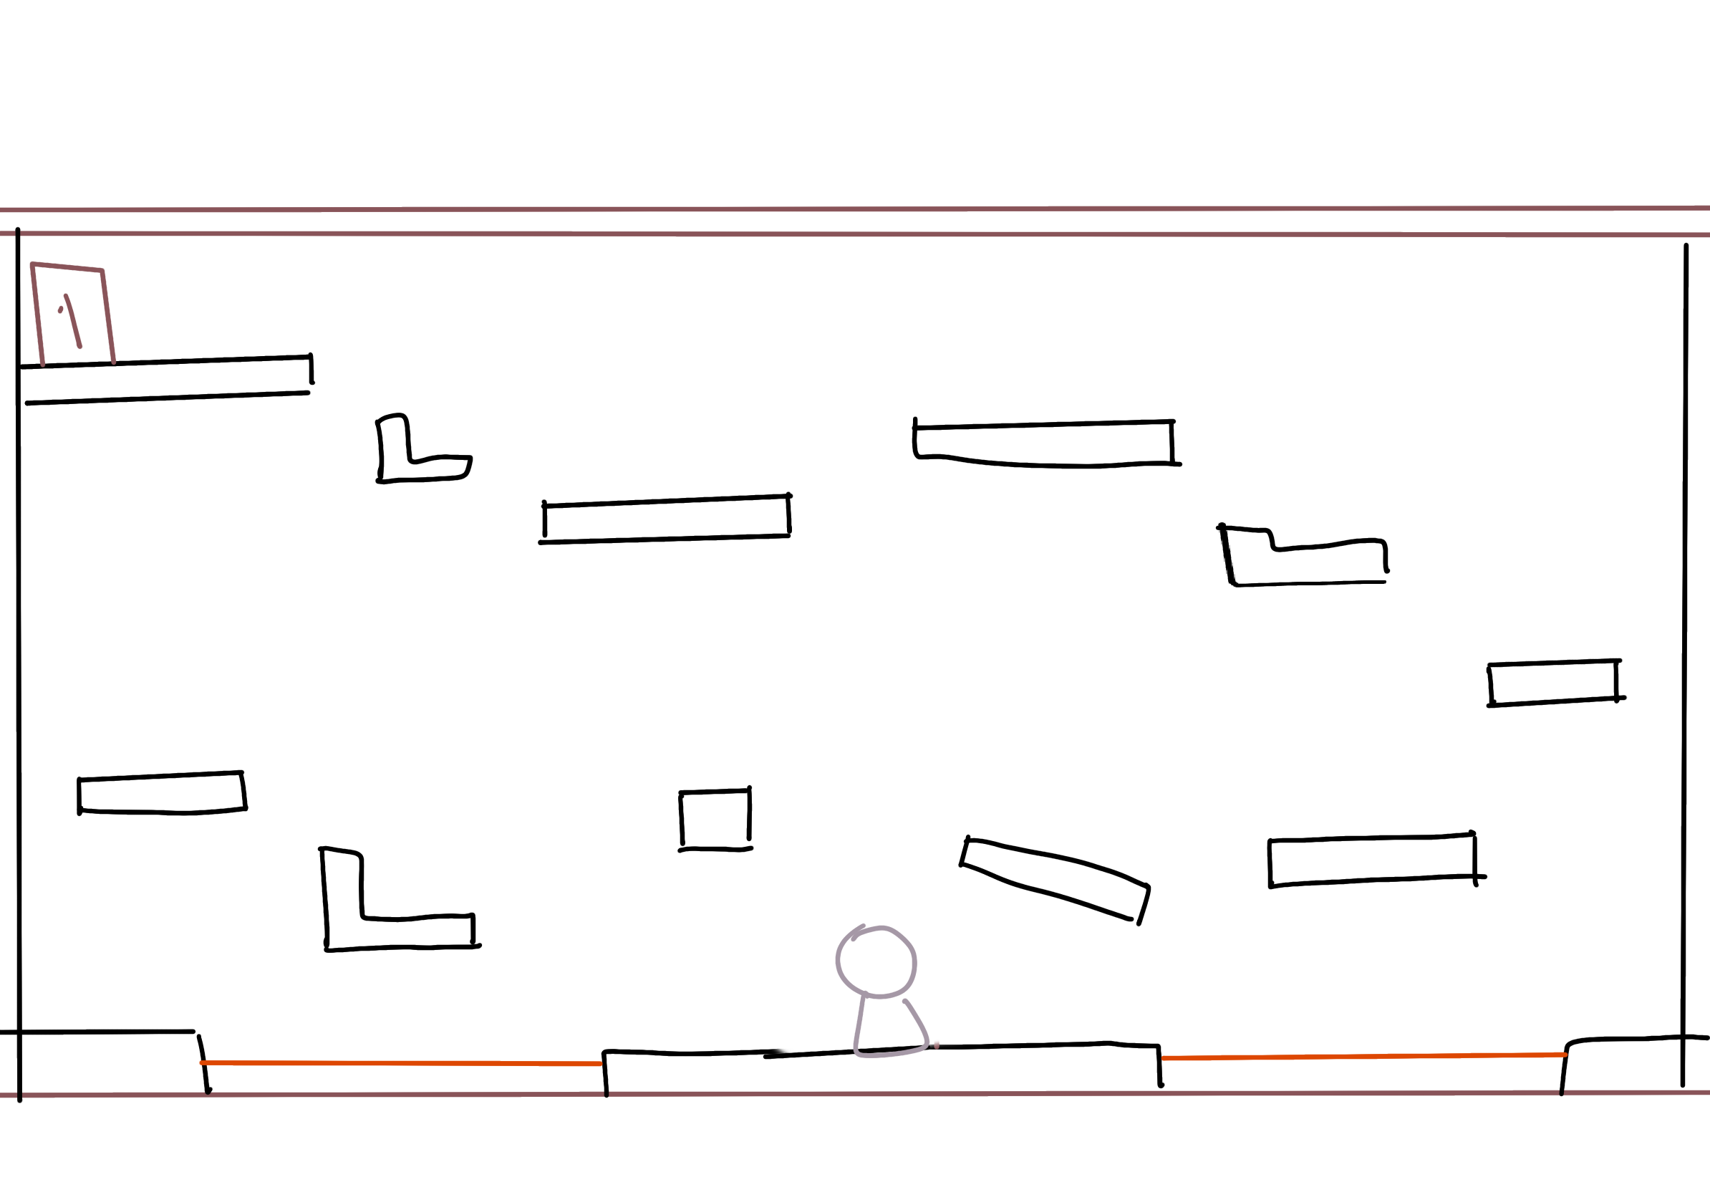
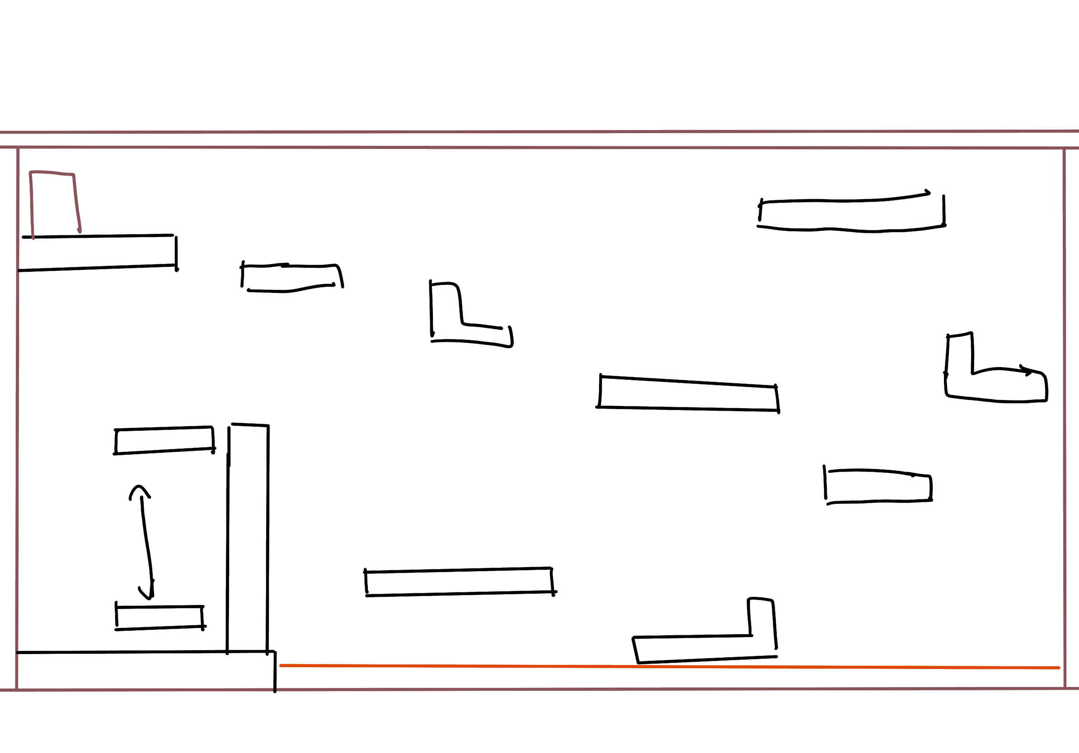
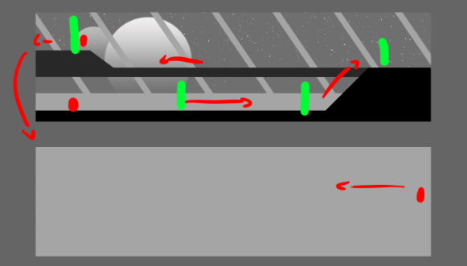
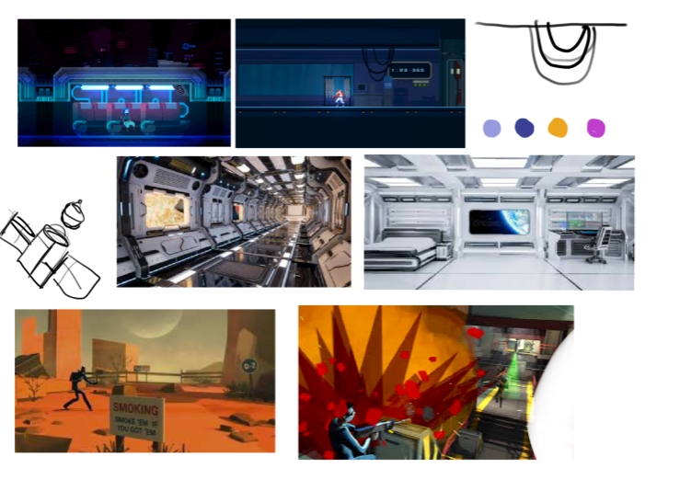
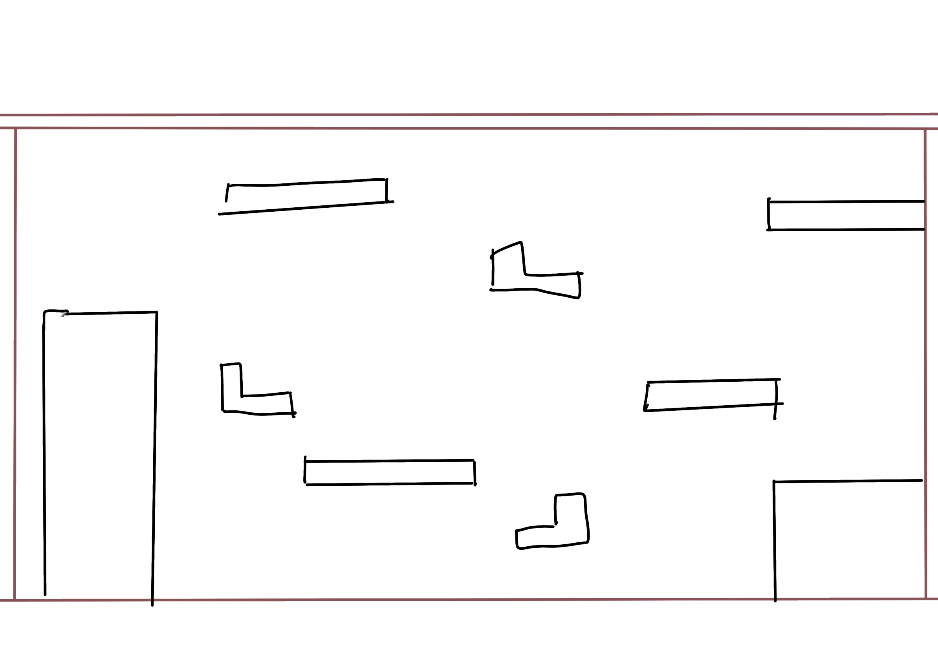
STAGE DESIGN
FOR EACH LEVEL

Slide 20
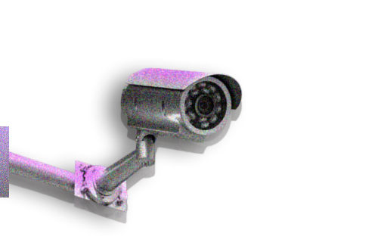
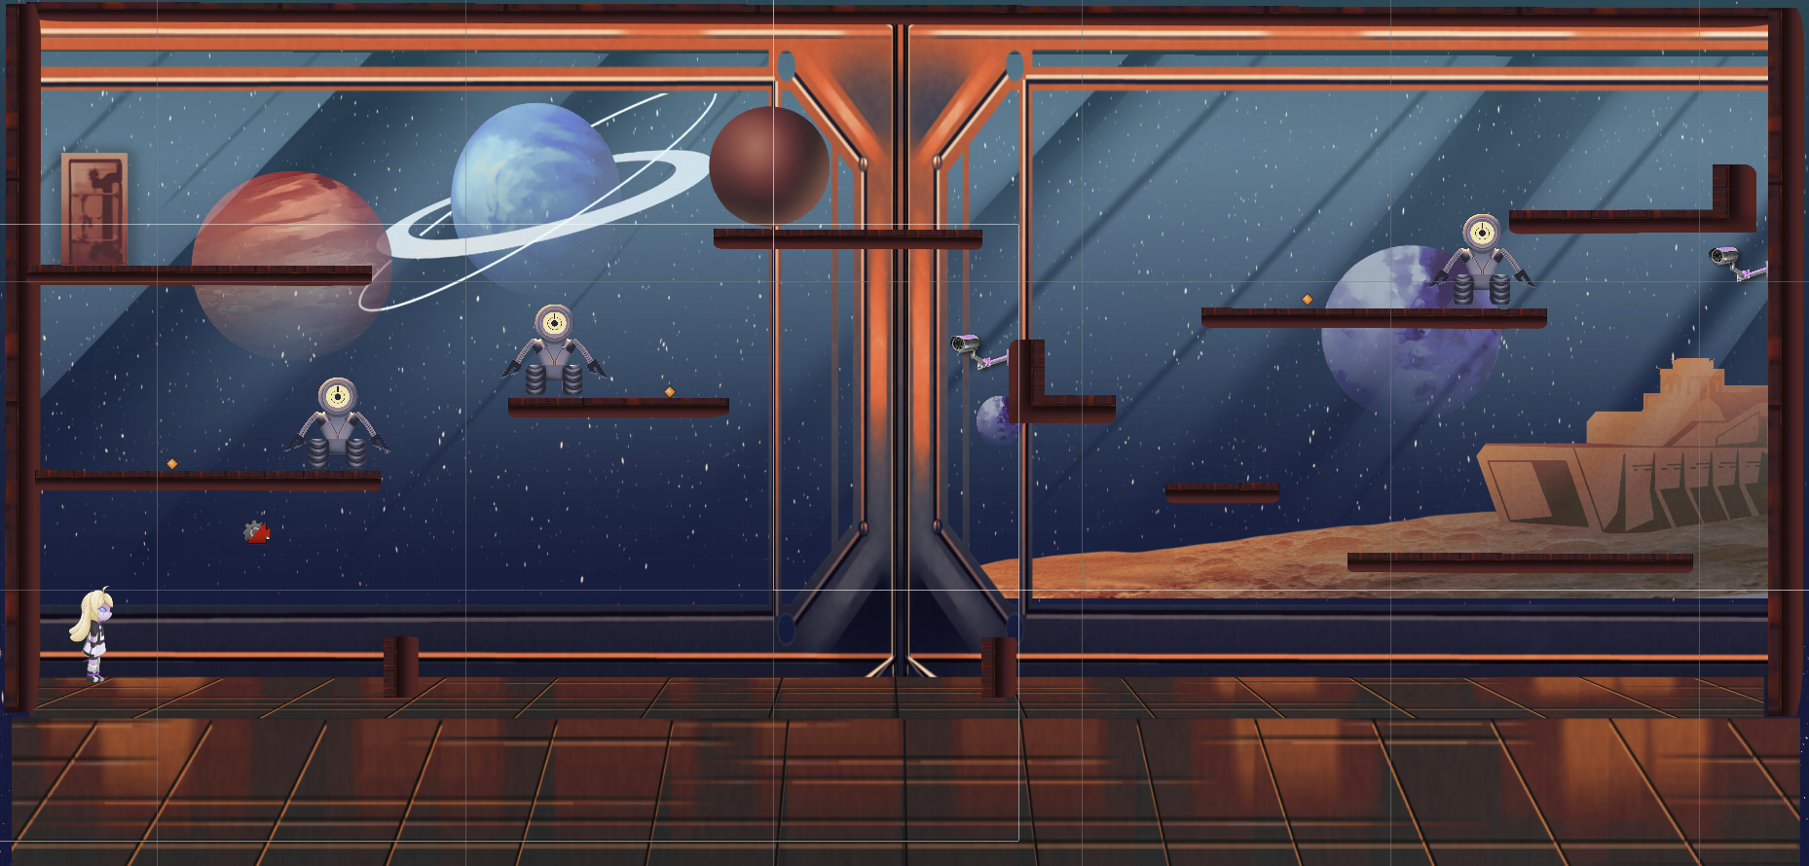
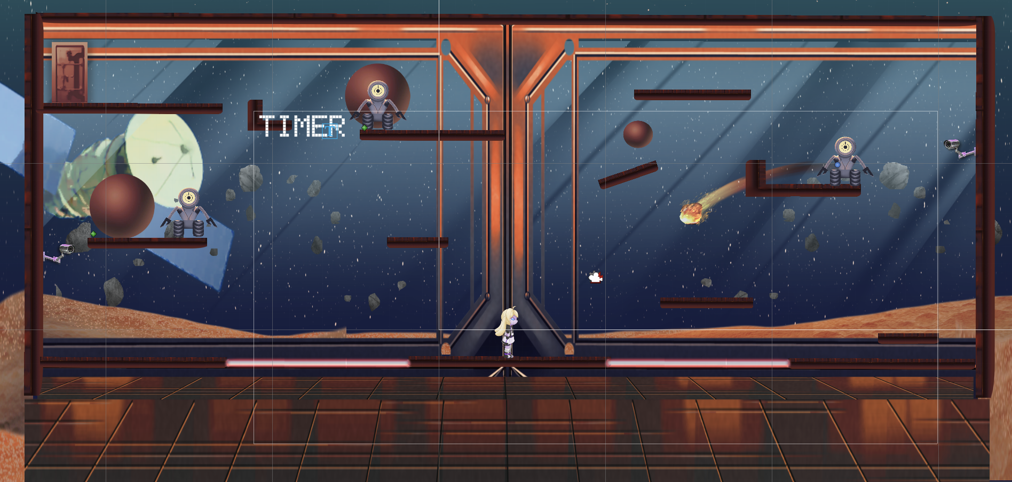
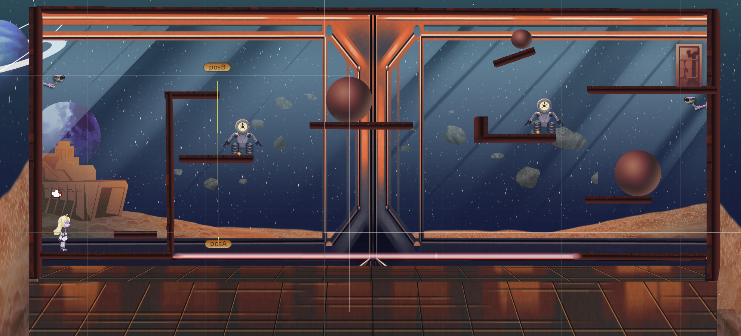
Final state of first 3 levels:
STAGE DESIGN
more obstacles added !
Level 1
Level 3
Level 2

Slide 21
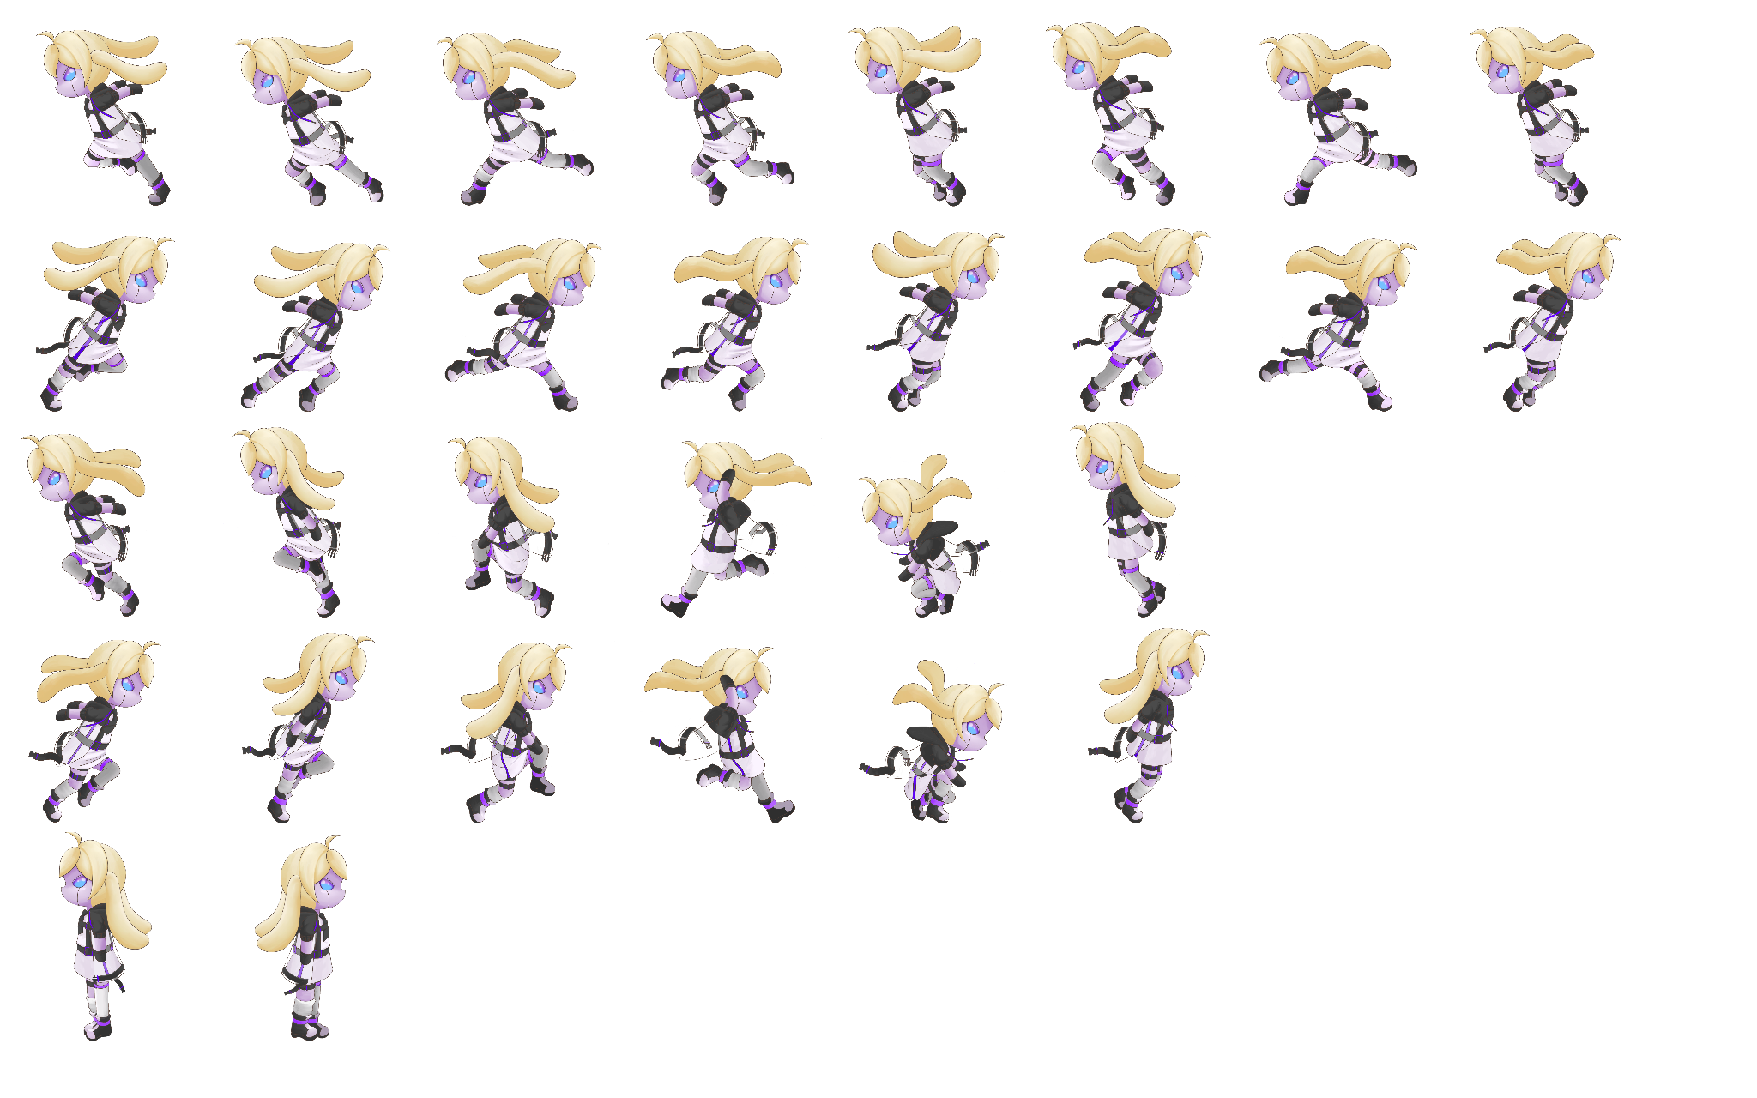
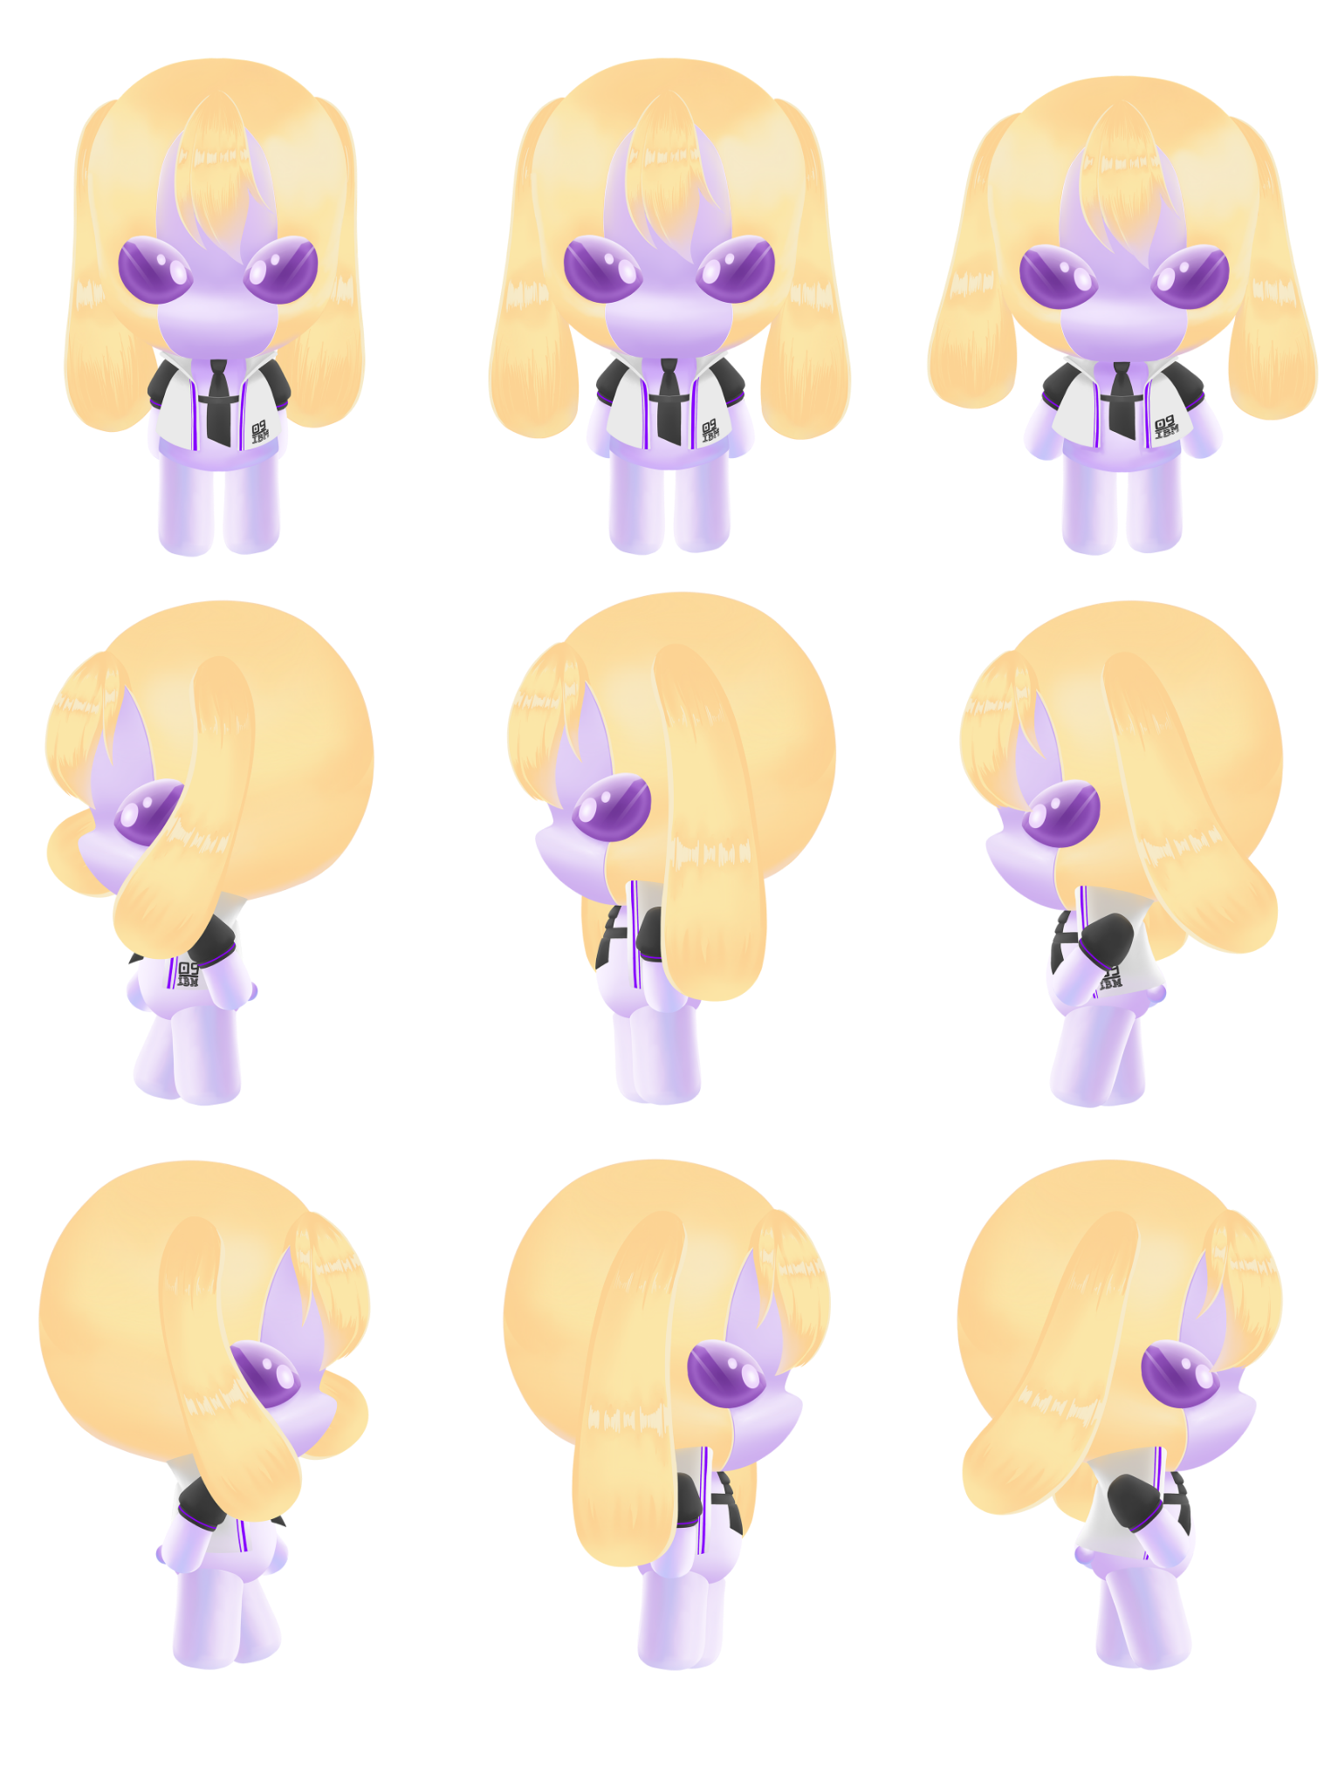
STAGE DESIGN
CHARACTER DESIGN EVOLUTION
Better Animations!

Slide 22
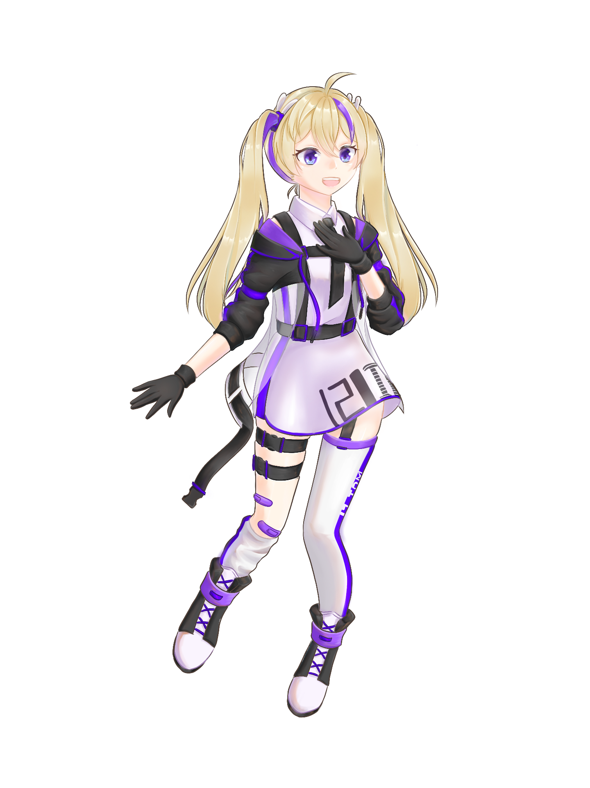



PLAYER
NPC
THE FINAL CHARACTERS

Slide 23
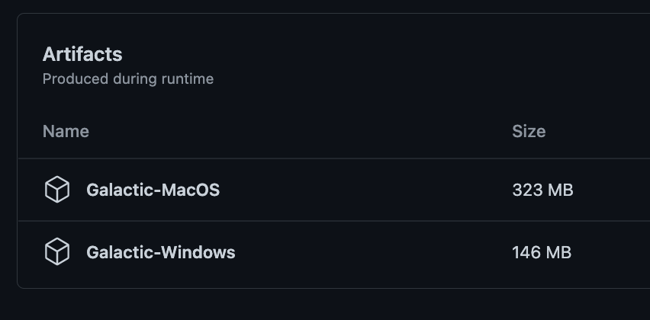


Deployment
Build for Mac and Windows
Build projects through github actions (workflow)
Workflow: validates Unity license, builds for the 2 platforms, (and releases)
Currently builds are only available as workflow artifacts

Slide 24
05
Review FINAL project plan

Slide 25
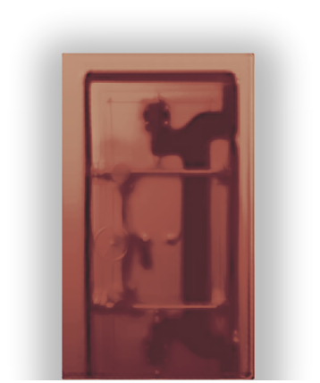
Procedural level generation
Include more info about the game (rules etc)
Improve incentive for player to improve knowledge
Add sub-objectives
Add the final boss level
Add a more comprehensive story to the game
Keep in touch with client
Add Final release

Slide 26

Thank You !
Platformer Stealth Game

